Slide 1
COVID-19 Data Analysis & Model Fine-Tuning
Insights, Model Development, and Predictions
Name: ABDULRAZAQ BATURE
DATE: 30/11/2024

Slide 2
Introduction
Objective: Analyze COVID-19 data, uncover trends, and fine-tune predictive models.
Key Questions:
How has COVID-19 evolved over time globally?
How can we predict future trends?
What factors influence the severity of the pandemic?

Slide 3
Dataset Overview
Rows: 49,068
Columns:
Province/State, Country/Region, Lat/Long, Date
Confirmed, Deaths, Recovered, Active
WHO Region

Slide 4
Data Cleaning and Preprocessing
Date Conversion: Convert the Date column to datetime format.
Missing Values: Filled missing Province/State with ‘Unknown’.
Feature Engineering: Created features like Daily Growth Rates,
Mortality Rates, and Active Cases.
Normalization: Applied MinMaxScaler to normalize numerical features.

Slide 5
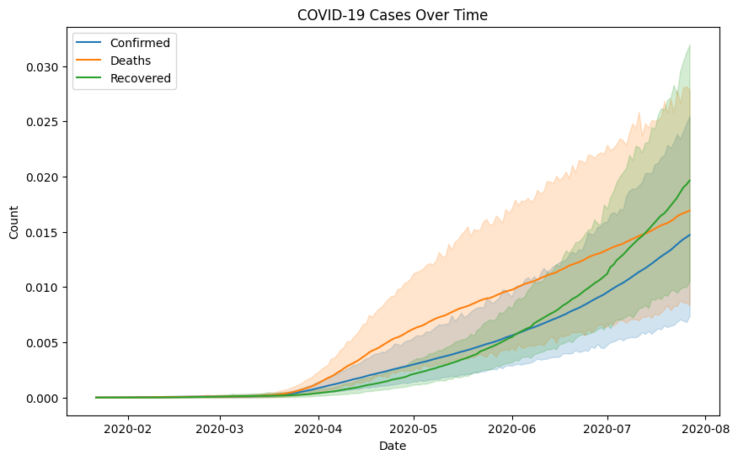
Exploratory Data Analysis (EDA)
Trends Over Time: Global rise in confirmed cases, deaths, and recoveries.
Correlation: Strong correlations between Confirmed, Deaths, and Recovered.

Slide 6
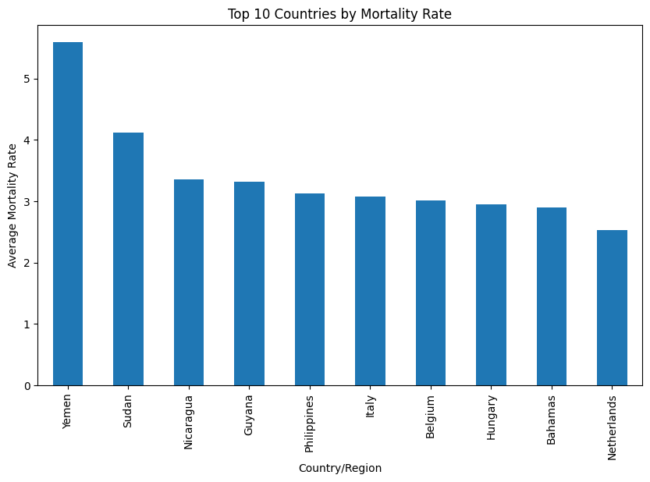
Mortality Rate Insights: Higher mortality rates in certain countries like Yemen, Sudan, and Nicaragua.

Slide 7
Model Selection & Evaluation
Time-Series Forecasting (Prophet):
Objective: Predict future trends for COVID-19 cases.
Outcome: Forecast for the next 30 days.
Hyperparameter Tuning:
Random Forest Regressor: Hyperparameter tuning using GridSearchCV.
Logistic Regression: For classification tasks predicting COVID case surges.

Slide 8
Model Evaluation Metrics
For Regression:
Mean Squared Error (MSE), Root Mean Squared Error (RMSE)
R-Squared to assess model fit.
For Classification:
Accuracy, Precision, Recall, F1-score
Confusion Matrix to visualize model performance.

Slide 9
Feature Importance
Random Forest: Analyzed feature importance to understand which factors most influence the predictions.
Features like Confirmed, Deaths, and Active Cases were the most impactful.

Slide 10
Key Insights and Recommendations
Global Trends:
Exponential rise in confirmed cases with varying recovery rates.
Country-Specific Insights:
Countries with high mortality rates require targeted healthcare interventions.
Predictive models (Prophet, Random Forest) can assist in forecasting future case surges.
Recommendations:
Use predictive models for real-time decision-making.
Focus on interventions in countries with high mortality and active cases.

Slide 11
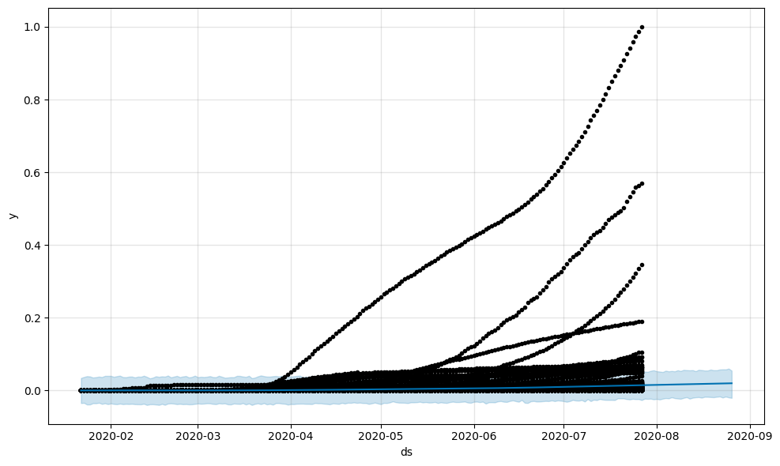
Forecasting Results (Prophet)
Visualize Forecast: Show a graph of the forecasted confirmed cases for the next 30 days.
Display confidence intervals and predicted trends.

Slide 12
Model Fine-Tuning Results
Random Forest Regressor: Show a graph of feature importance.
Accuracy Metrics: Display the final metrics for both the regression and classification models.

Slide 13
Conclusion
Summary:
Successfully preprocessed and analyzed COVID-19 data.
Fine-tuned predictive models to forecast future trends and surges.
Generated insights to assist healthcare systems in managing future outbreaks.
Next Steps:
Continue monitoring and adjusting models as new data becomes available.
Implement model predictions for early intervention planning.

